Slide 1
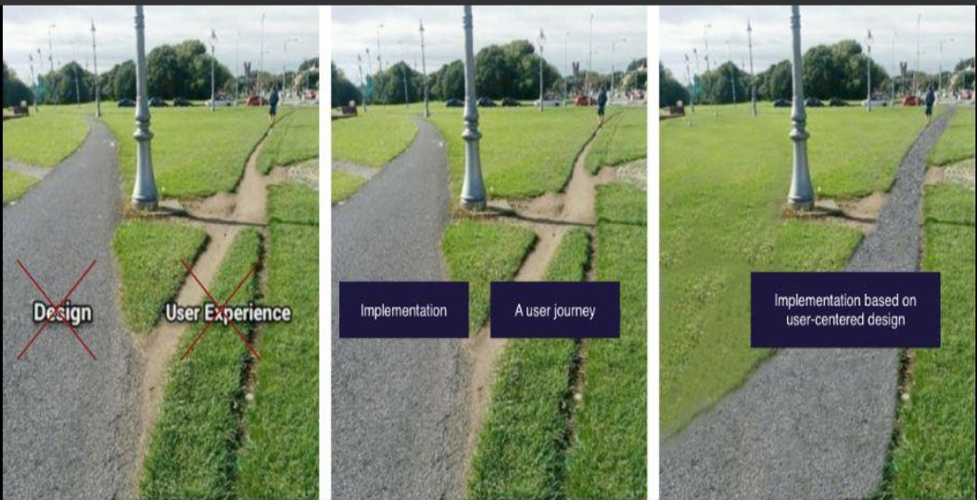
User Exprience Design/ Amir Dirin
https://padlet.com/amir_dirin1/x40de2ccmiyacoae

Slide 2
User Experience
Code:DIG2TN002 / DIG2TA002-300X
Scope: 5 ECTS (135h)
Timing: 2ndsemester, 1stperiod
Language: English
Course level: Profile studies
Course type: Elective

Slide 3
Date |  | Topic
18.1 |  | Introduction
19.01 |  | students setup
25.01 |  | UCD application demo
26.01 |  | students Activities
1.02 |  | User Study /Methods
2.02 |  | Students Activities, Interview
8.02 |  | Students Presentation /Result
9.02 |  | Analysis/ interview transcript coding
15.02 |  | Students activities
16.02 |  | Presentation/ requirements spc.
22.02 |  | Concept development
23.02 |  | Students activities / Scenario Design
1.03 |  | Concept Evaluation
2.03 |  | Introduction to paper prototype
8.03 |  | Students activities /Prototypeing
9.03 |  | Prototype evaluation
15.03 |  | Final Presentation
16.03 |  | Final Report

Slide 4
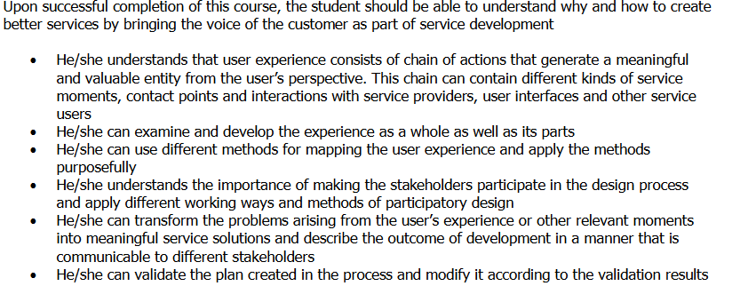
Learning Objective

Slide 5
Lectures
1. During Covid-19 in Teams
https://teams.microsoft.com/l/team/19%3a0193ea761d6c47e68f35bff40a007464%40thread.tacv2/conversations?groupId=60463a6f-d149-49c0-a1ae-a02e2be61fc9&tenantId=a9e39483-dd21-4c25-b848-2a625cff7939
In teams you can find the lectures note, assignments, and the latest news.
2. Moodle is used for durable and extended information about each lectures.
3. You have to return your individual / home / project assignments to Moodle.

Slide 6
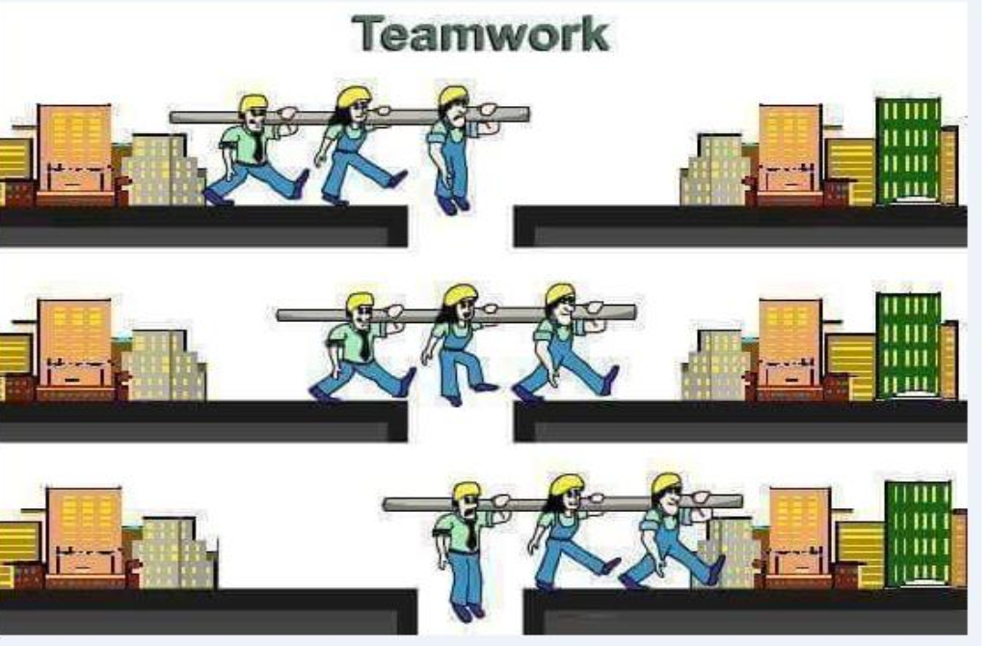
Team Work

Slide 7
Lecture participation
All teams-based lectures are compulsory to participate, so please be there incase you are not able to participate let me know in advance
Often Mondays time is allocated to lectures and Tuesdays group assignments

Slide 8
Constructive_learning
Features | Descriptive | Application on UXD
Active | Knowledge is only acquired through autonomous and active participation | For each assignment, a final aim is set and practical objectives must be completed, including activities with digital technologies. Students work autonomously in an online environment and infrastructure
Constructive | Knowledge is only acquired when build into existing knowledge and can be interpreted on individual’s experience | Information is given on the spot for a practical task during an assignment or must be researched by the students during a task. After a step by step description, further tasks must be solved autonomously. To strengthen the learning process, each assignment includes retrospective questions at the end. An early, simple introductory lecture on the field of the subject is given for framing and follow up usage of knowledge in the remaining part of course
Emotional | For knowledge acquisition to happen, positive emotions are crucial | No marks for the work decrease negative stress and reinforce a feeling of success after having passed the tasks. After answering the retrospective, the team receives the next assignment.
Self-directed | The learner must control and monitor own learning process | There is a timetable schedule, student teams work self-paced. To dig deeper, students can pick sections from the tasks or watch additional info in video tutorials
Social | l Acquisition of knowledge occurs through interaction with others | Online collaboration and problem solving in teams of students.
Situative | Knowledge acquisition is tied to a specific situation or context. Learning always takes place within the context of a specific learning environment | For the Learning Lab, online breakout rooms are used The lecturer works as a coach and assists only upon request. The background of the tasks is focused on a realistic issue to be solved. The motivation is improved by a coherent scenario.

Slide 9
Presentation Topics

Slide 10
Presentation Topic
User study methods
Benefits of Usability
Usability evaluation methods
User Centered Design and Development
Case study Usability evaluations
ISO 9421-2010 / 2018
Use Context.
User experience Design
Human Factors in design
Color psychology
Gestalt Theory
Affective computing

Slide 11
Interview
Audio and video taping
Questionnaires
Experiments
Diary
Shadowing
Question1. What are the criteria to select the user study method

Slide 13
Usage of the product
Financial benefits
Customer satisfaction

Slide 14
Presentation task:
Each group must prepare a 25 minutes presentation on the given topic.
5 minutes for Q&A
Each group have to raise two questions from their own presentation that other students need to answer.
You will be asked to submit your answers to the presentations question at the end of the course (individual assignment)

